Slide 1
MongoDB Indexes

Slide 2
MongoDB Indexes
Indexes are an important part of your application.
To speed up a query, you can create an index for a field of a collection.
When you insert, update, or delete the documents from the collection, MongoDB needs to update the index accordingly
An index improves the speed of document retrieval at the cost of additional write and storage space to maintain the index data structure.
Internally, MongoDB uses the B-tree structure to store the index
we will use sample_mflix database and movies collection

Slide 3


List indexes of a collection
By default, all collections have an index on the _id field.
To list the indexes of a collection, you use the getIndexes() method with the following syntax
In this syntax, the collection is the name of the collection that you want to get the indexes.
For example, the following shows the indexes of the movies collection in the mflix database
The output shows the index name '_id_' and index key _id. The value 1 in the key : { _id : 1 } indicates the ascending order of the _id values in the index.
When an index contains one field, it’s called a single field index. However, if an index holds references to multiple fields, it is called a compound index.

Slide 4
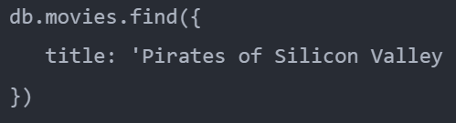

Explain a query plan
The following query finds the movie with the title Pirates of Silicon Valley
To find the movie, MongoDB has to scan the movies collection to find the match.
Before executing a query, the MongoDB query optimizer comes up with one or more query execution plans and selects the most efficient one.
To get the information and execution statistics of query plans, you can use the explain() method

Slide 5
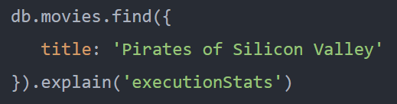
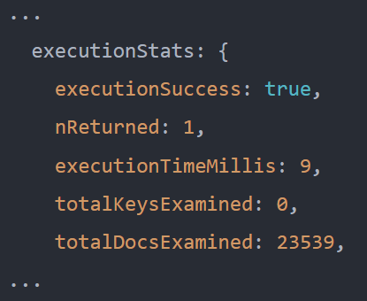
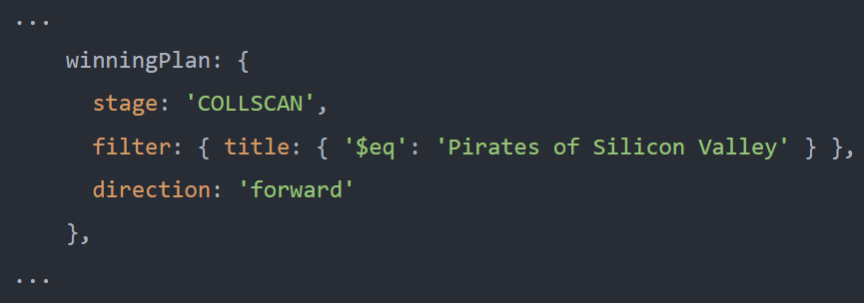
Explain a query plan
For example, the following returns the query plans and execution statistics for the query that finds the movies with the title Pirates of Silicon Valley
The explain() method returns a lot of information. And you should pay attention to the following winningPlan
Also, the executionStats shows that the result contains one document and the execution time is 9 milliseconds
The winningPlan returns the information on the plan that the query optimizer came up with. In this example, the query planner comes up with the COLLSCAN that stands for the collection scan.

Slide 6

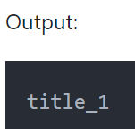
Create An Index For A Field In A Collection
To create an index for the title field, you use the createIndex() method as follows
In this example, we pass a document to the createIndex() method.
The { title: 1} document contains the field and value pair where:
The field is the index key .
The value describes the type of index for the year field.
The value 1 for descending index and -1 for ascending index.
The createIndex() method returns the index name.
In this example, it returns the title_1 which is the concatenation of the field and value

Slide 7
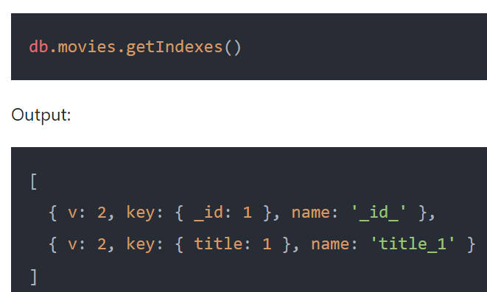
Create An Index For A Field In A Collection
The following query shows the indexes of the movies collection
The output shows two indexes, one is the default index and another is the year_1 index that we have created.
By default, MongoDB names an index by concatenating the indexed keys and each key’s direction in the index ( i.e. 1 or -1) using underscores as a separator.
For example, an index created on { title: 1 } has the name title_1

Slide 8
Create An Index For A Field In A Collection
An index improves the speed of document retrieval at the cost of additional write and storage space to maintain its data structure.
Use the createIndex() method to create an index for a field in a collection.
Use the getIndexes() method to list the indexes of a collection.
Use the explain() method to get the information and execution statistics of query plans.

Slide 9


MongoDB Drop Index
To drop an index from a collection, you use the db.collection.dropIndex() method
In this syntax, the index specifies an index to be dropped.
The index can be either a string that specifies the name of an index or a document that describes the specification of the index that you want to drop.
Note that you cannot drop the default index on the _id field.
Starting in MongoDB 4.2, you cannot use the db.collection.dropIndex('*') to drop all non-_id indexes. Instead, you use the dropIndexes() method

Slide 10
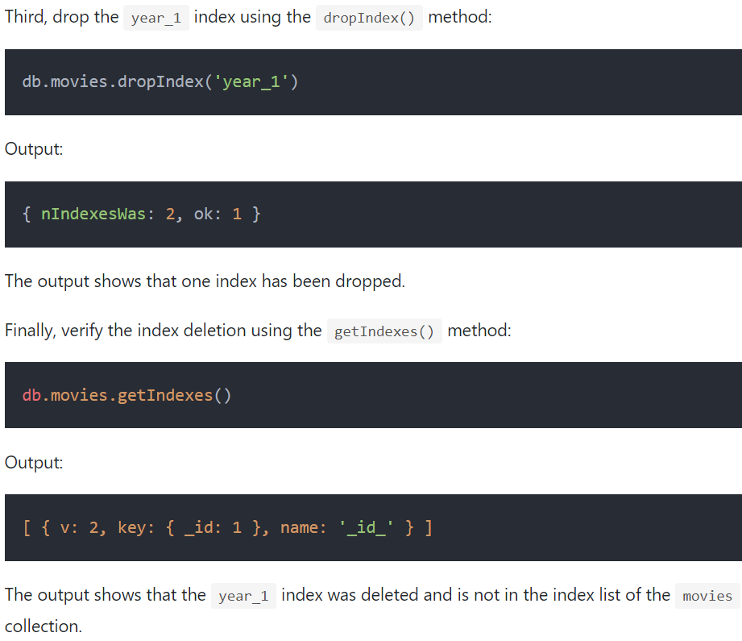
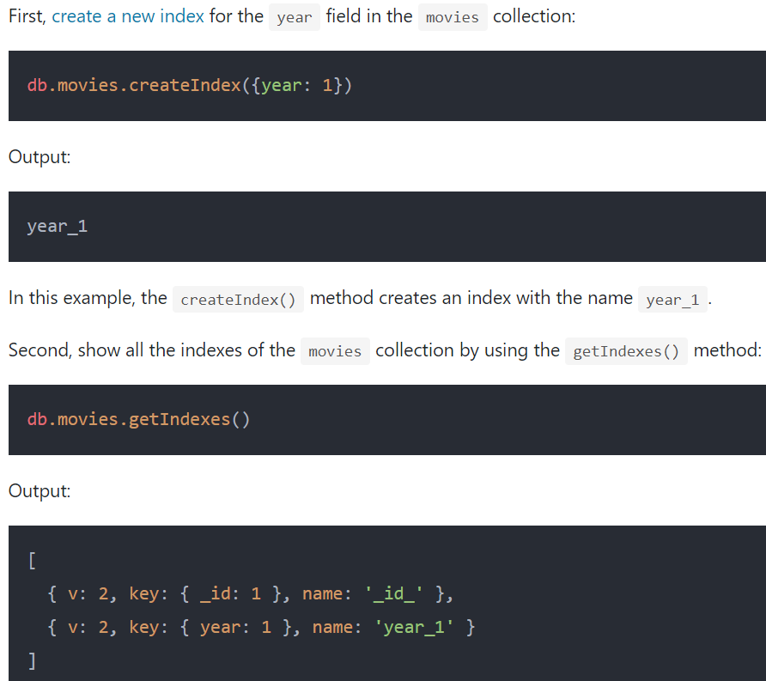
Drop An Index - Example

Slide 11
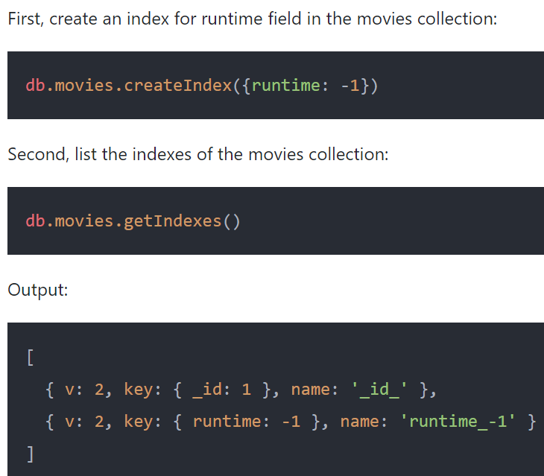
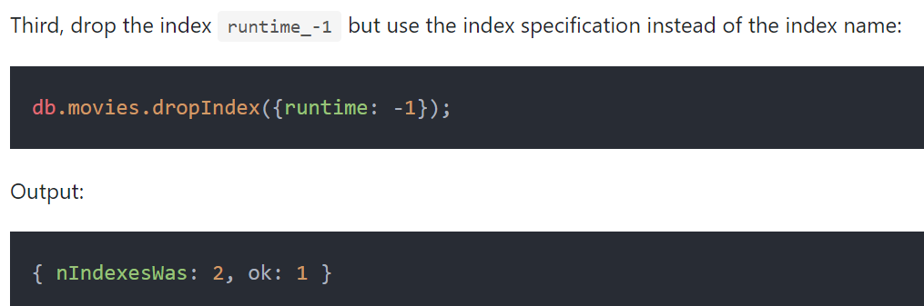
Drop an index by the index specification

Slide 12
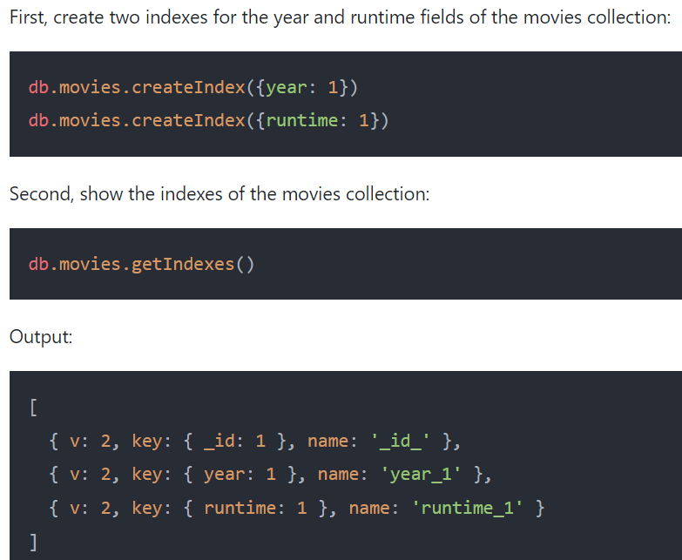
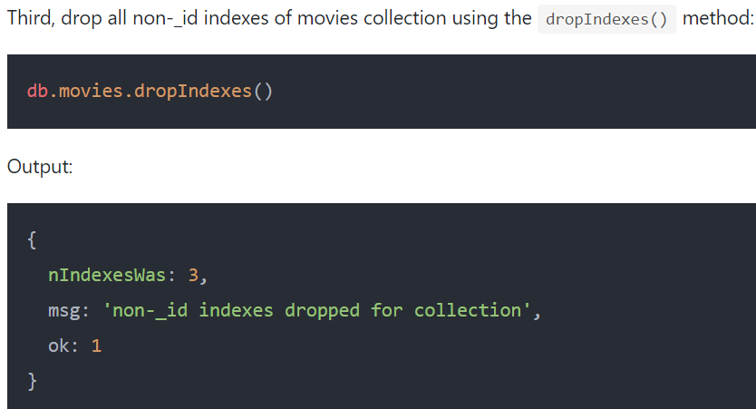
Drop all non-_id indexes example

Slide 13
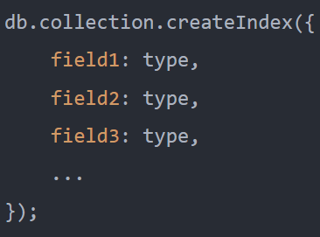
MongoDB Compound index
A compound index is an index that holds a reference to multiple fields of a collection.
In general, a compound index can speed up the queries that match on multiple fields.
In this syntax, you specify a document that contains the index keys (field1, field2, field3…) and index types.
The type describes the kind of index for each index key. For example, type 1 specifies an index that sorts items in ascending order while -1 specifies an index that sorts items in descending order.
MongoDB allows you to create a compound index that contains a maximum of 32 fields.
It’s important to understand that the order of the fields specified in a compound index matters.
If a compound index has two fields: field1 and field2, it contains the references to documents sorted by field1 first. And within each value of field1, it has values sorted by field2.
Besides supporting queries that match all the index keys, a compound index can support queries that match the prefix of the index fields. For example, if a compound index contains two fields: field1 and field2, it will support the queries on:
field1
field1 and field2
However, it doesn’t support the query that matches the field2 only.

Slide 14
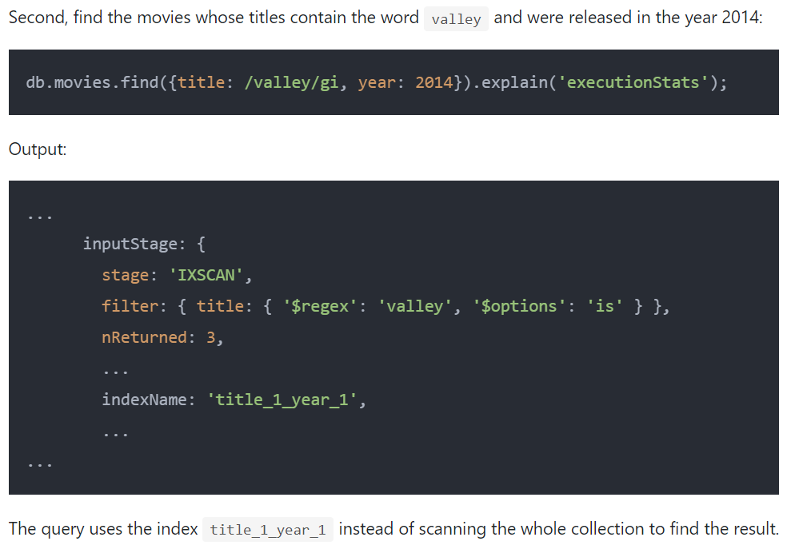
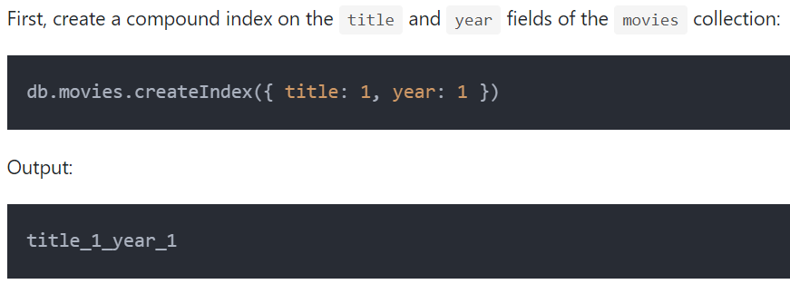
MongoDB compound index example

Slide 15
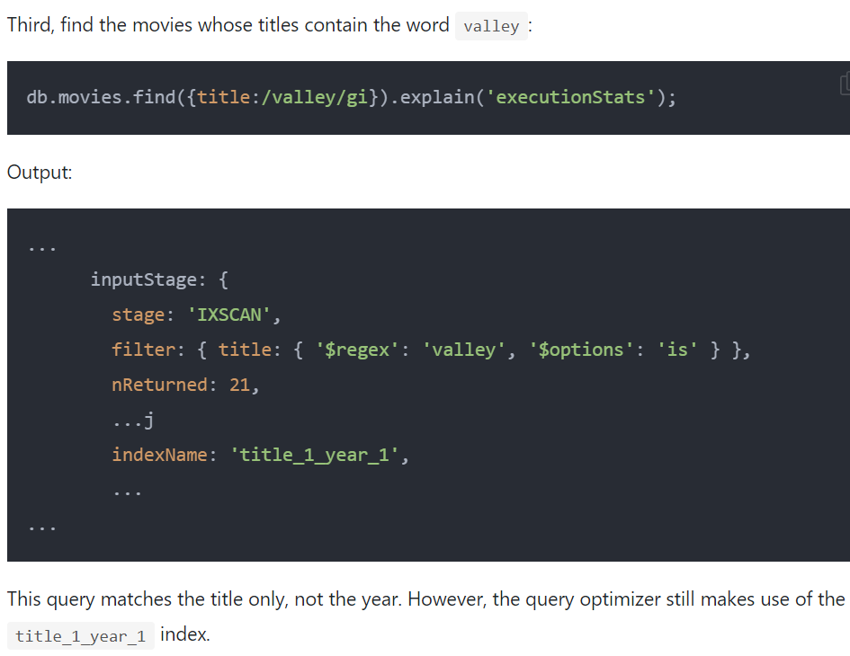
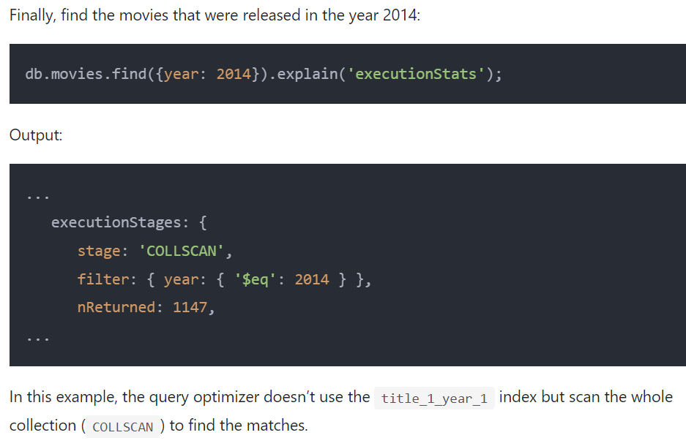
MongoDB compound index example

Slide 16
MongoDB Unique Index
Often, you want to ensure that the values of a field are unique across documents in a collection, such as an email or username.
A unique index can help you to enforce this rule.
In fact, MongoDB uses a unique index to ensure that the _id is a unique primary key.
To create a unique index, you use the createIndex() method with the option {unique: true} like this:

Slide 17
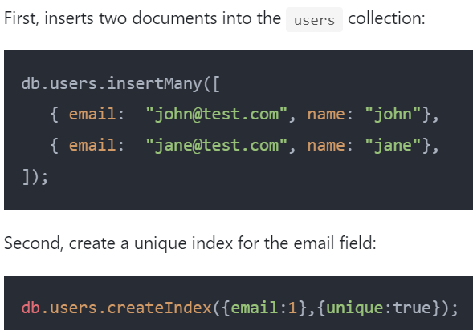
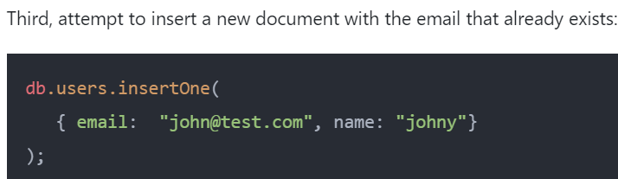
Create a unique index for a field
MongoDB returned the following error:
MongoServerError: E11000 duplicate key error collection: mflix.users index: email_1 dup key: { email: "john@test.com" }

Slide 18
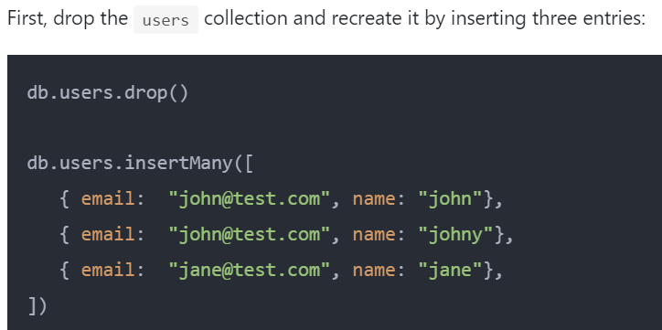
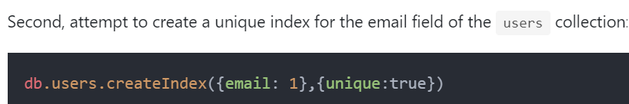
Create a unique index for collection with duplicate data
MongoDB returned the following error:
MongoServerError: Index build failed: 95f78956-d5d0-4882-bfe0-2d856df18c61: Collection mflix.users ( 6da472db-2884-4608-98b6-95a003b4f29c ) :: caused by :: E11000 duplicate key error collection: mflix.users index: email_1 dup key: { email: "john@test.com" }
The reason is that the email has duplicate entries john@test.com

Slide 19
Create a unique index for collection with duplicate data
Typically, you create a unique index on a collection before inserting any data.
By doing this, you ensure uniqueness constraints from the start.
If you create a unique index on a collection that contains data, you run the risk of failure because the collection may have duplicate values.
When duplicate values exist, the unique index creation fails as shown in the previous example.
To fix this, you need to review data and remove the duplicate entries manually before creating the unique index.

Slide 20
Unique compound index
When a unique index contains more than one field, it is called a unique compound index.
A unique compound index ensures the uniqueness of the combination of fields
To create a unique compound index, you specify fields in the index specification like this

Slide 21
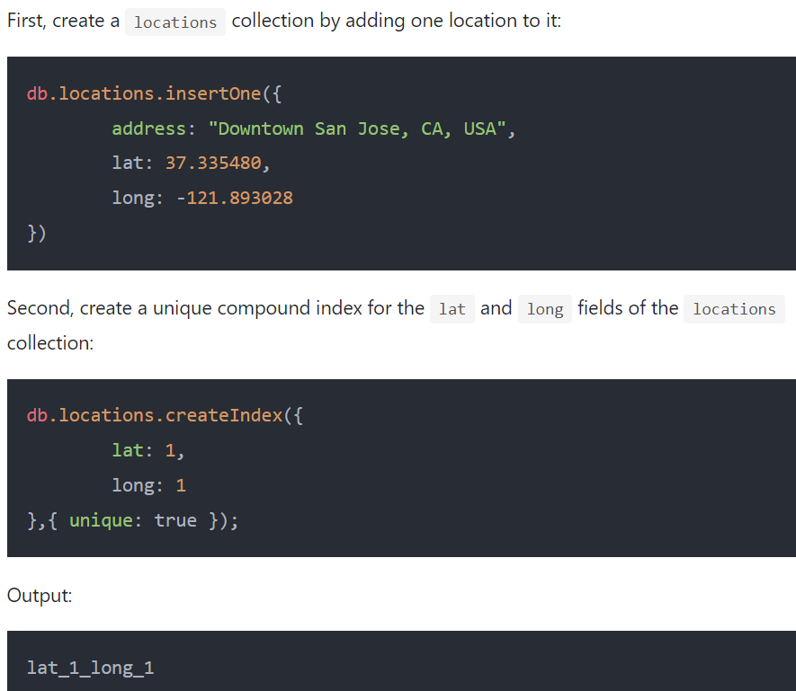
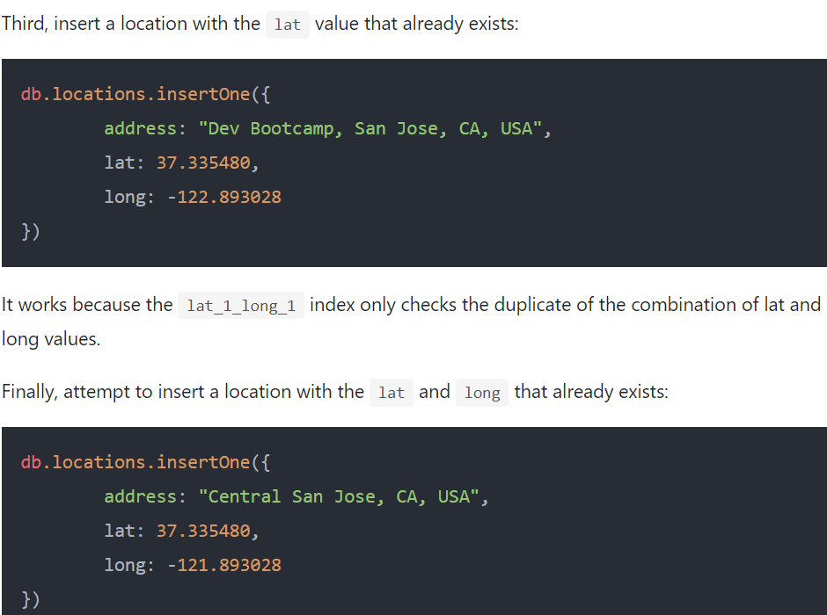
Unique compound index - Example
MongoDB issued the following error:
MongoServerError: E11000 duplicate key error collection: mflix.locations index: lat_1_long_1 dup key: { lat: 37.33548, long: -121.893028 }

